Slide 1
Virtual Machines
Jochem Arends

Slide 2
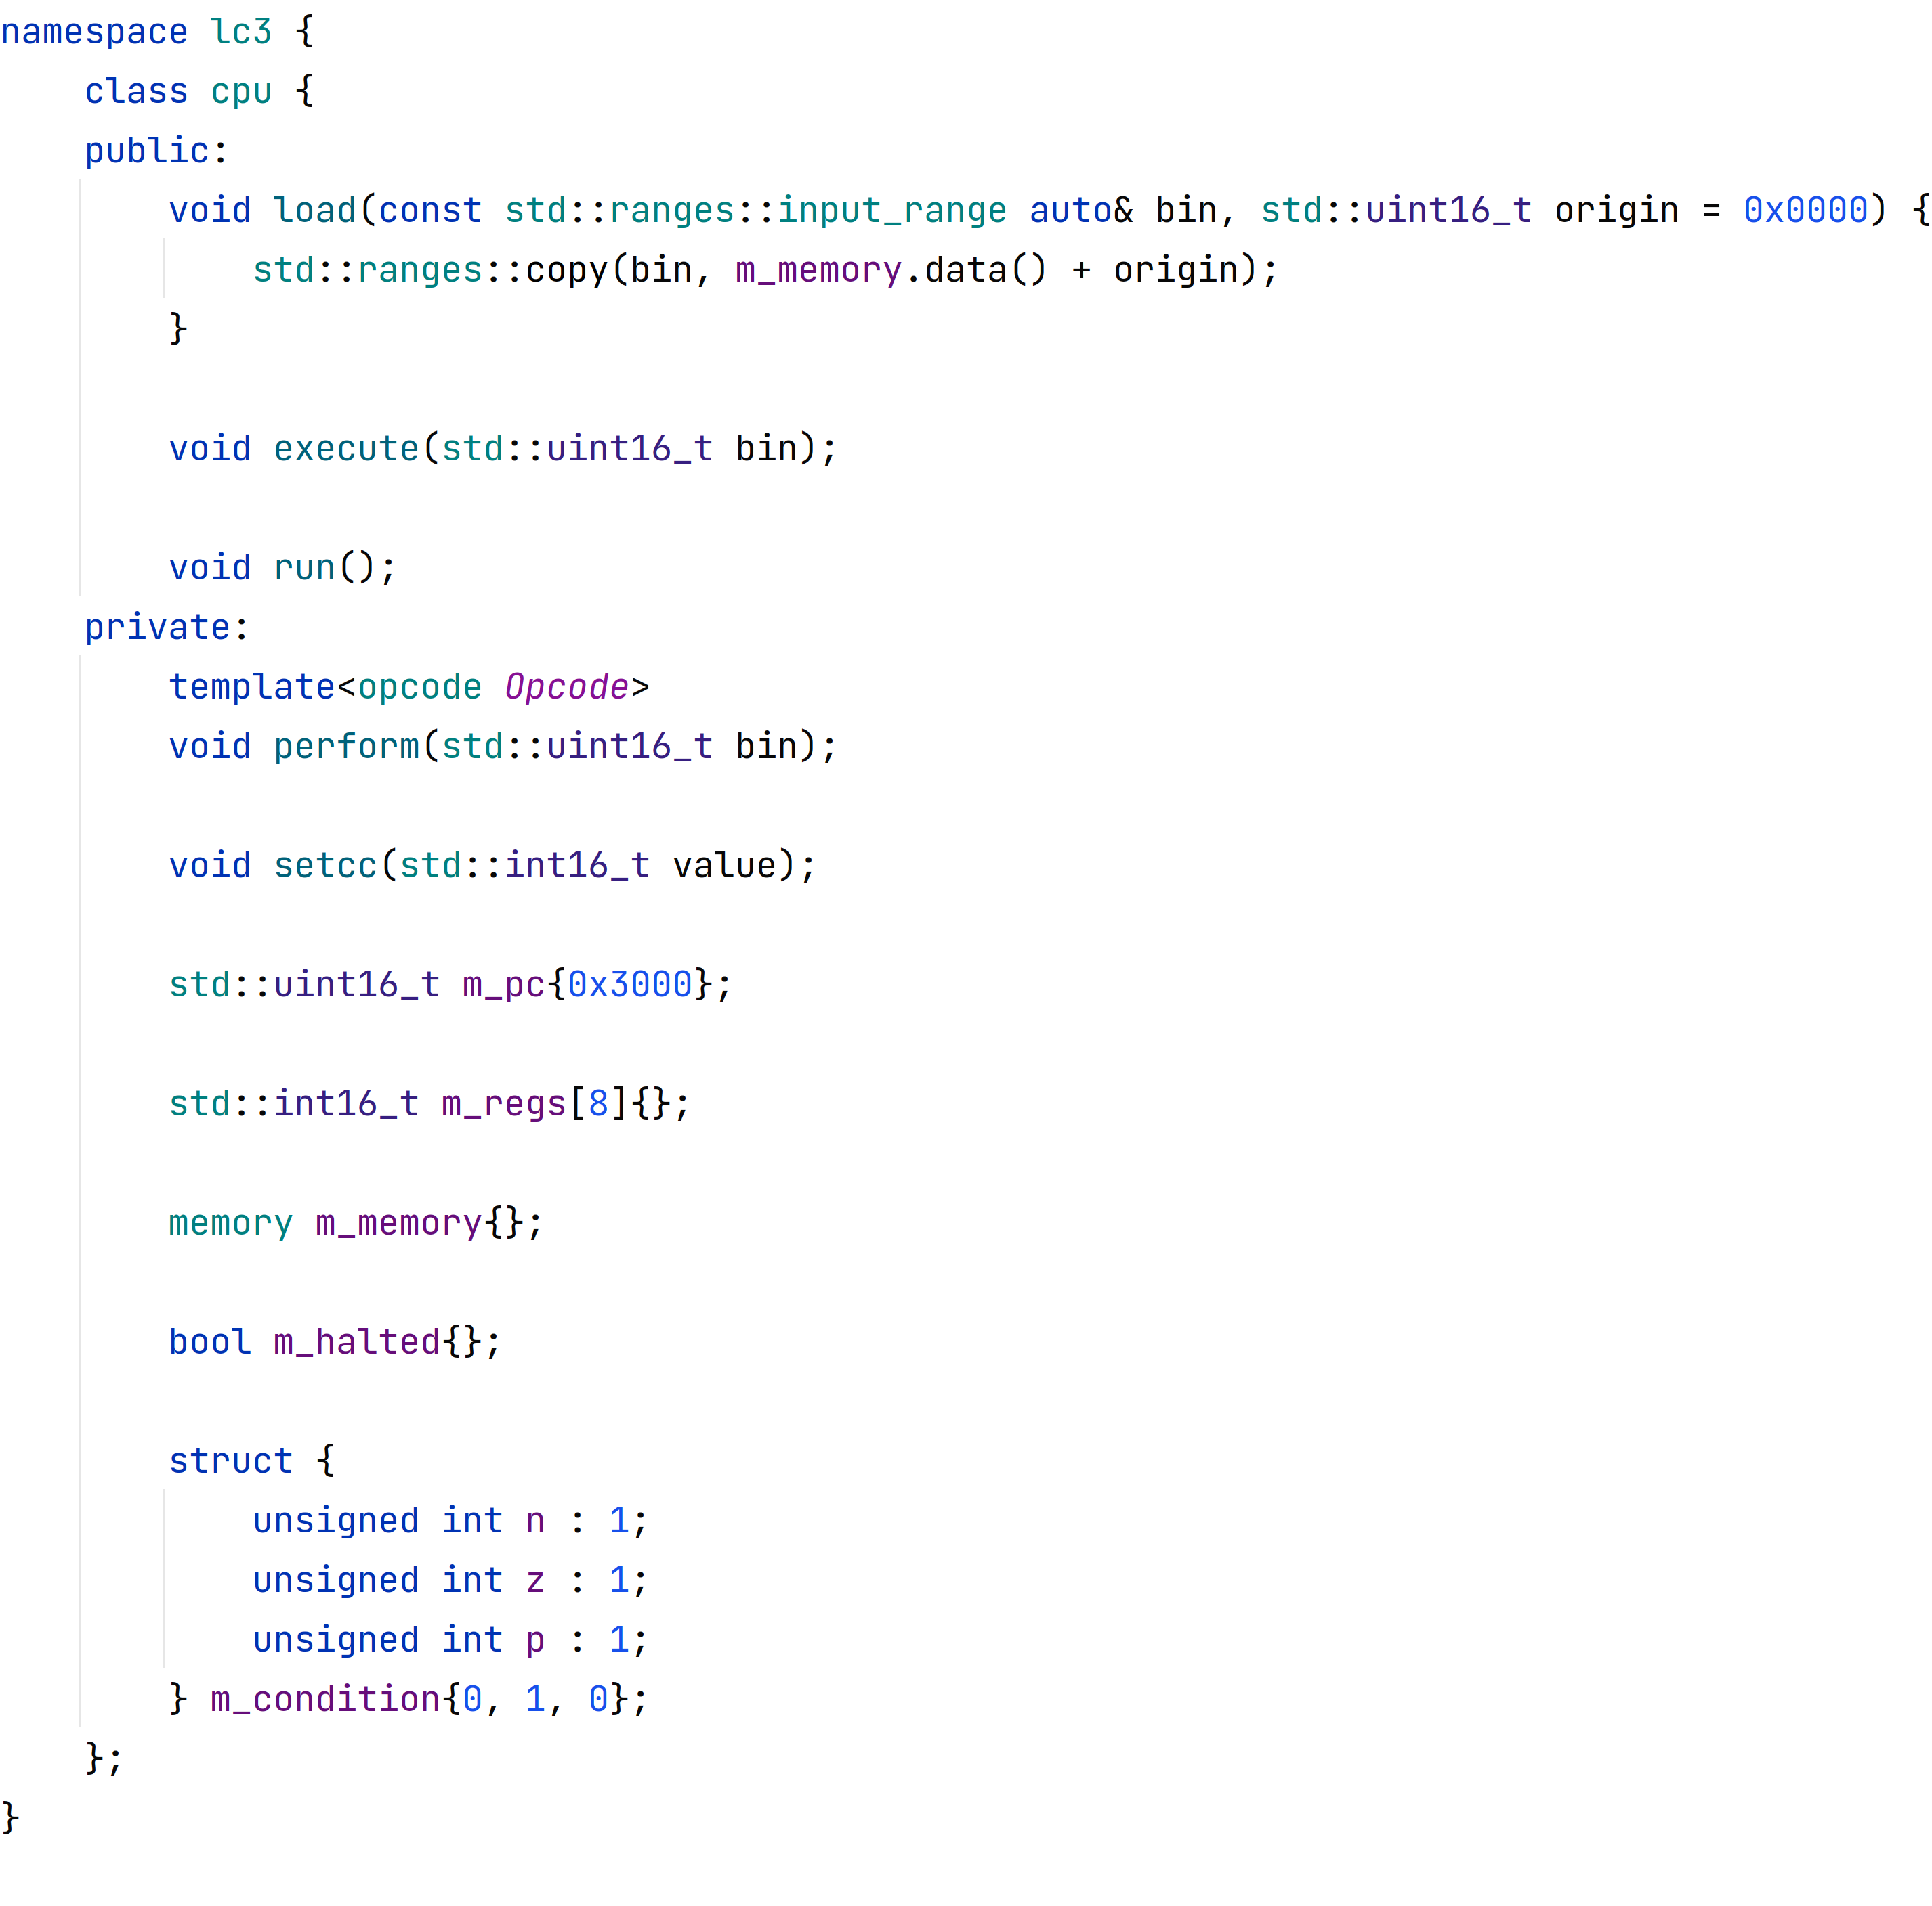
Little Computer 3 (LC-3)
an educational architecture
minimal instruction set
registers
conditional codes

Slide 3
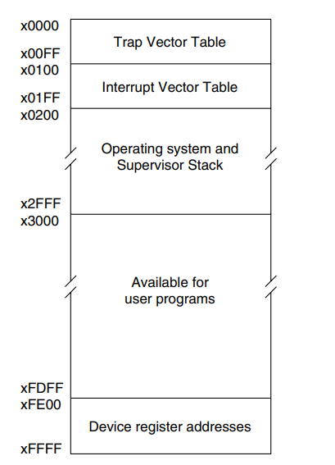
Memory
16-bit addressable memory
little-endian
memory mapped IO
two’s complement

Slide 4
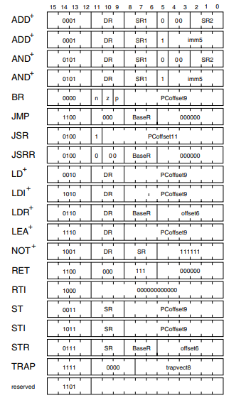
Instruction Encoding
4-bit wide opcodes
same operation, multiple encoding
components have constant position and size

Slide 5
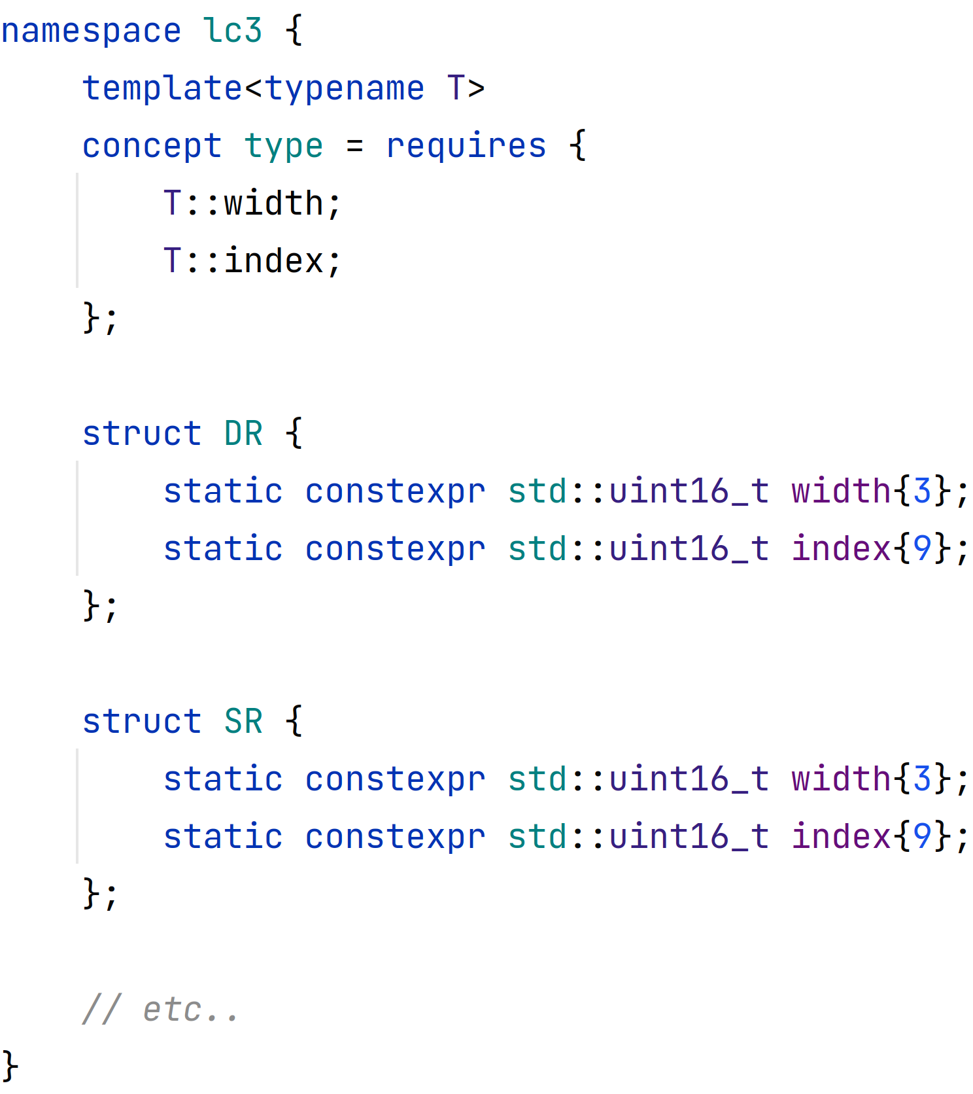
Instruction Encoding
each “type” can be represented by a width and a index (starting at the the LSB)
generic function for decoding

Slide 6
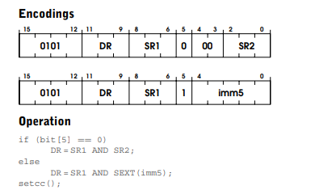
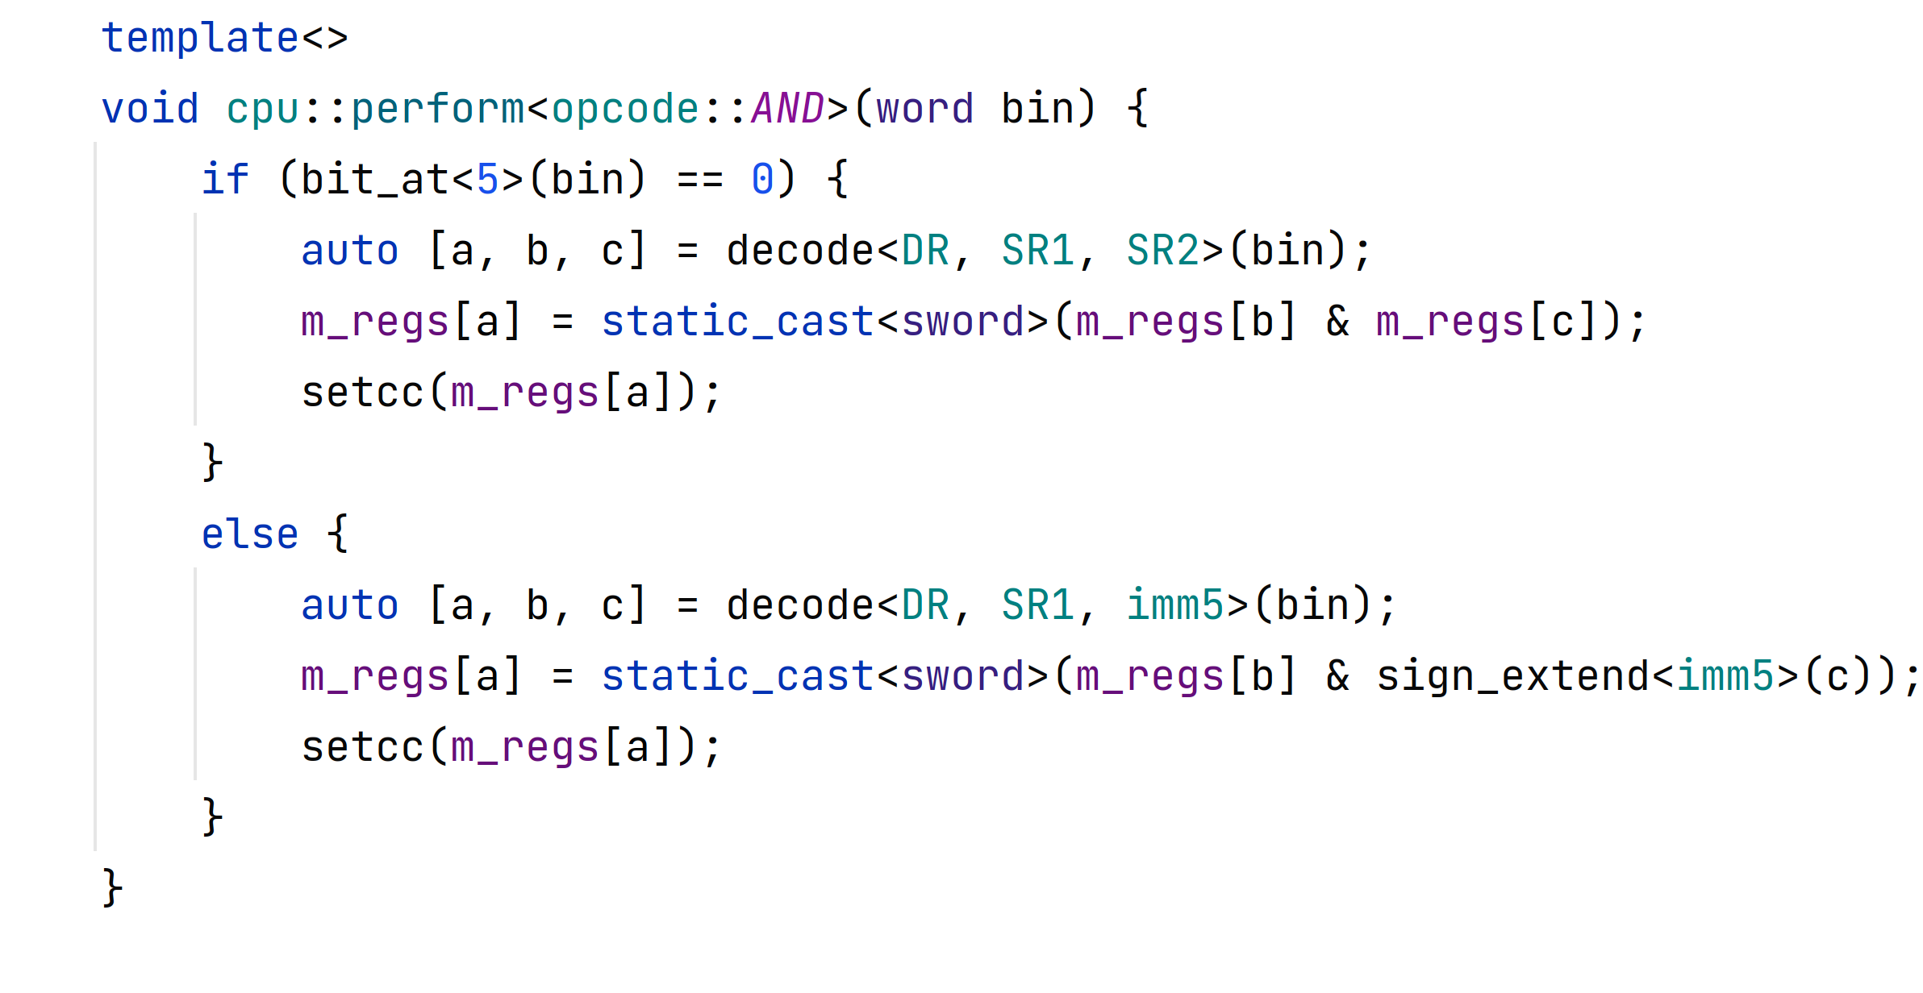
Instruction Decoding
logic of the bitwise AND

Slide 7
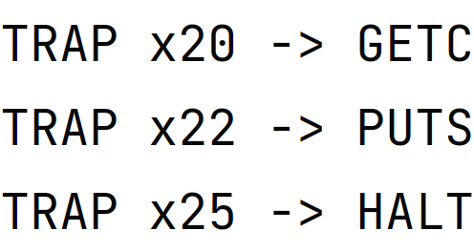
System Calls
TRAP instruction
console I/O
halt processor

Slide 8
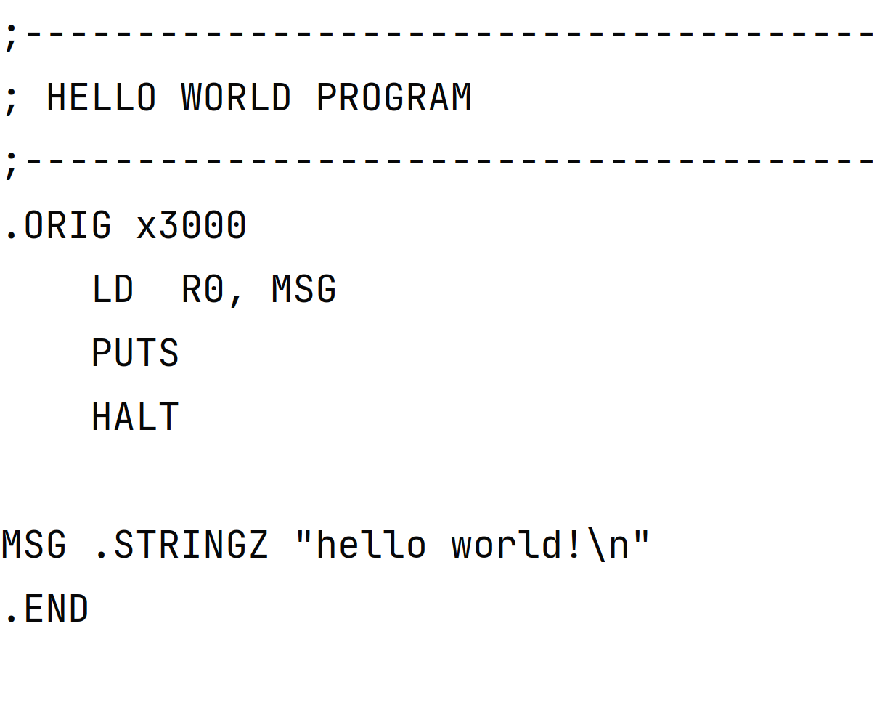
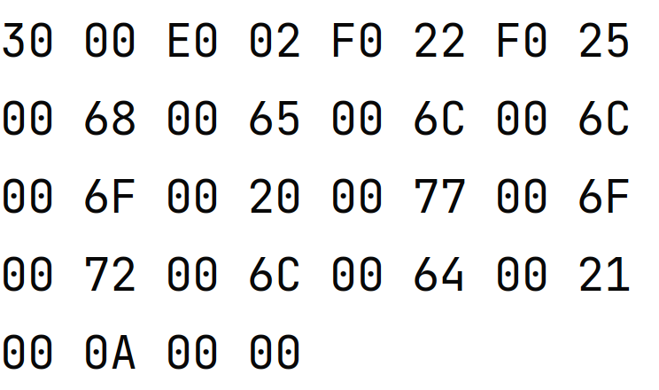
Assembling
https://wchargin.com/lc3web/

Slide 9
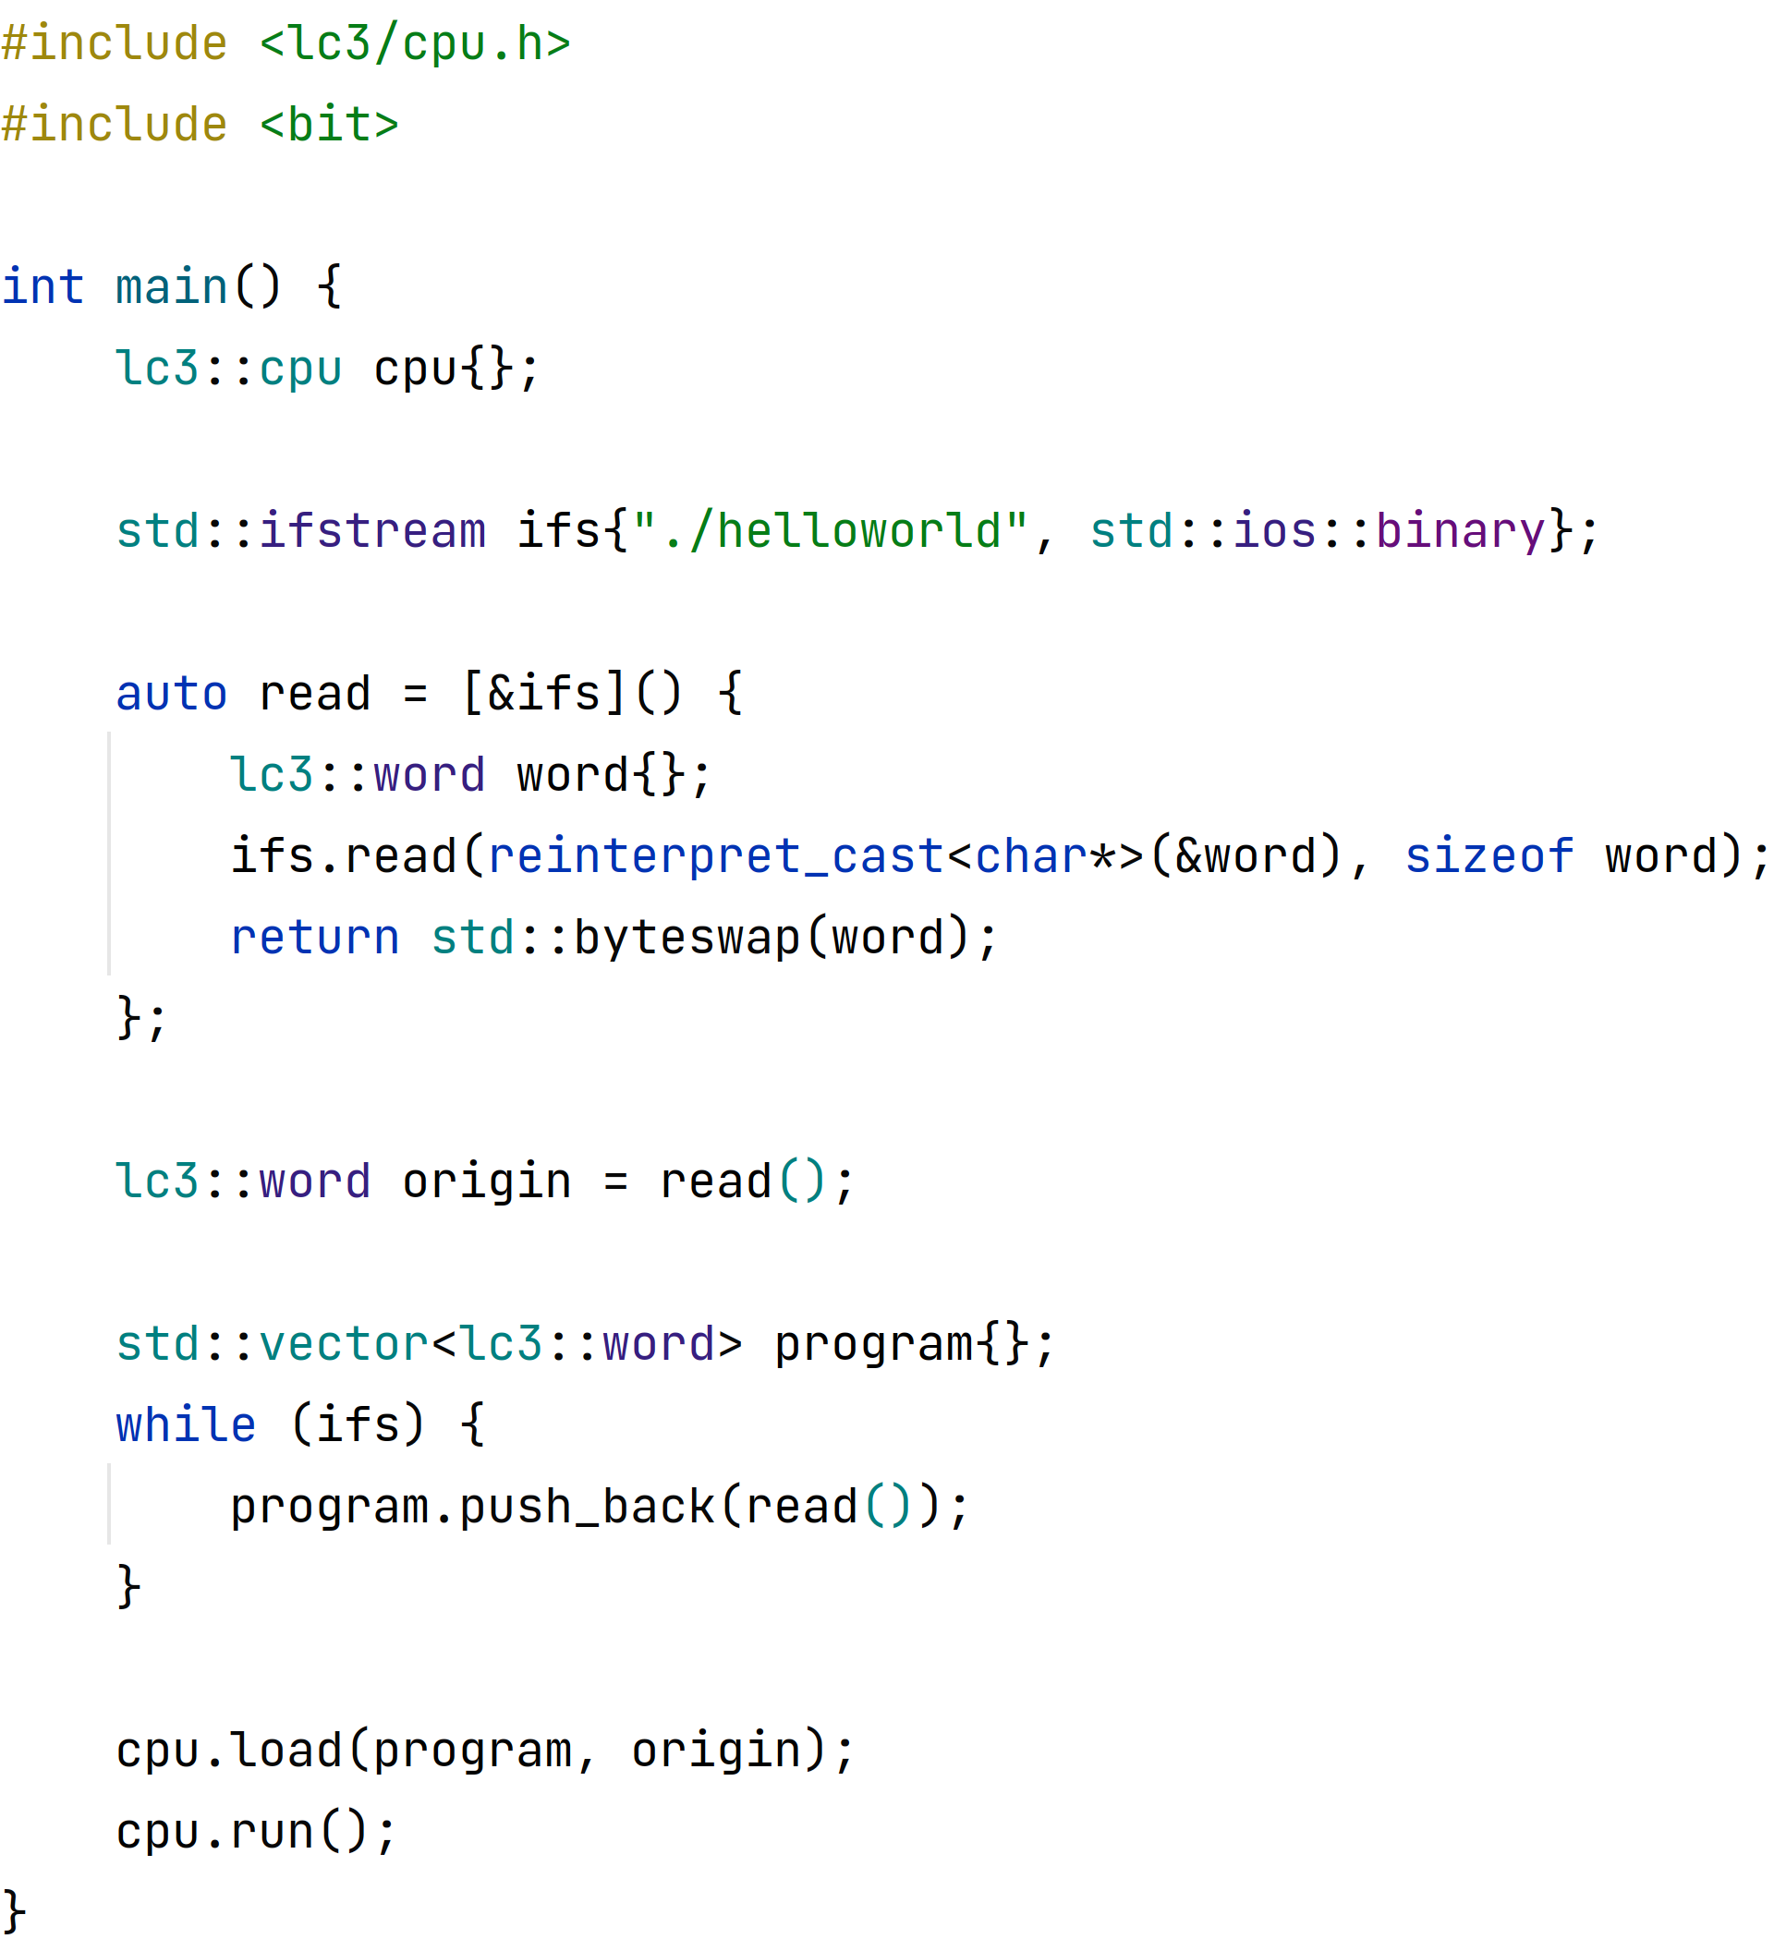
Loading Object Files
1st word is where program should be loaded
rest contains instructions
big-endian to little-endian

Slide 10
Limitations
comparing or subtracting
bit shifting
text-based input/output
unsigned data

Slide 11
Resources Used
LC-3 details: https://www.jmeiners.com/lc3-vm/supplies/lc3-isa.pdf
assembler: https://wchargin.com/lc3web/

Slide 12
Questions?

